Slide 1

STARBUCKS SALES DATA ANALYSIS
TANMAY NAGDEVE

Slide 2
ABOUT THE DATA SET
The Starbucks sales dataset has been obtained from Kaggle. It includes two csv files Orders_Table & Products_Table.
The csv files have been transformed using the power query editor in PowerBI and later the data model was created.
An interactive dashboard is then created with all the important data necessary to draw business insights.

Slide 3
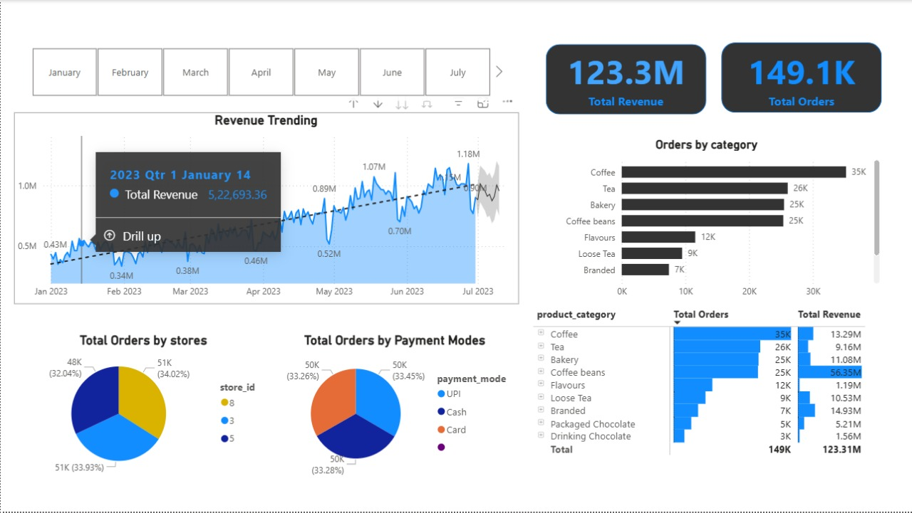
POWER BI DASHBOARD

Slide 4
INSIGHTS DRAWN
The business has generated a total revenue of 123.3 Million and processed a total of 149.1K orders up to June 2023.
The "Revenue Trending" line chart shows a clear upward trend in revenue from January 2023 to June 2023, indicating consistent growth over the first seven months of the year. There appears to be some seasonality, with dips in revenue followed by recovery and growth. The projected trend line suggests continued growth into the near future.
"Coffee" is the Top Order Category: "Coffee" leads significantly in terms of the number of orders, with 35K orders. "Tea" and "Bakery" also have substantial order volumes at 26K orders each.
The table on the right confirms that the top order categories also contribute significantly to total revenue. "Coffee" generated 13.29M, "Bakery" 11.08M, and "Tea" 9.16M in revenue.
The pie chart for "Total Orders by stores" indicates that Store 3 has the highest share of total orders at 51K (33.93%). Store 5 is the next largest contributor with 51K (34.02%), followed by Store 8 with 48K (32.04%). The distribution across these top three stores is relatively even.

Slide 5
INSIGHTS DRAWN
The "Total Orders by Payment Modes" pie chart shows that UPI and Cash are the most popular payment methods, each accounting for 50K (33.26%) of the total orders. Card payments also contribute significantly with 50K (33.45%). The "Other" payment mode has a negligible share.

